Slide 1
Matrix I
Oct. 7, 2019
Doug Young Suh

Slide 2
Contents
Matrix + -
Matrix *
Orthogonal
Binary file IO

Slide 3
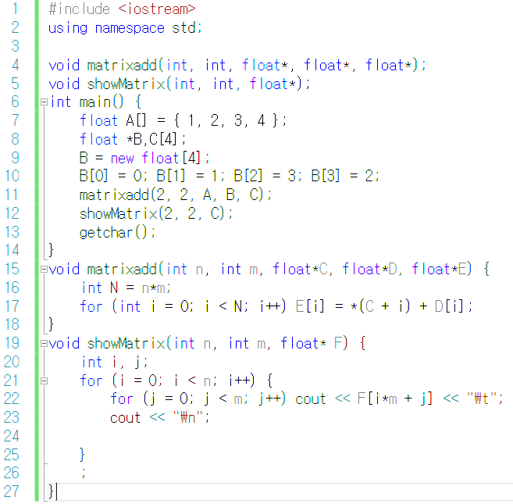



Matrix addition
C = A + B
$\left[\begin{matrix}1 & 2 \\ 3 & 4\end{matrix}\right]$+
$\left[\begin{matrix}0 & 1 \\ 3 & 2\end{matrix}\right]$=
$$\left[\begin{matrix}1 & 3 \\ 6 & 6\end{matrix}\right]$$

Slide 4
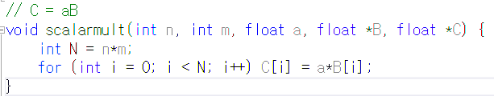

Scalar multiplication
2A
$2\left[\begin{matrix}1 & 2 \\ 3 & 4 \\ 5 & 6\end{matrix}\right]=\left[\begin{matrix}2 & 4 \\ 6 & 8 \\ 10 & 12\end{matrix}\right]$

Slide 5
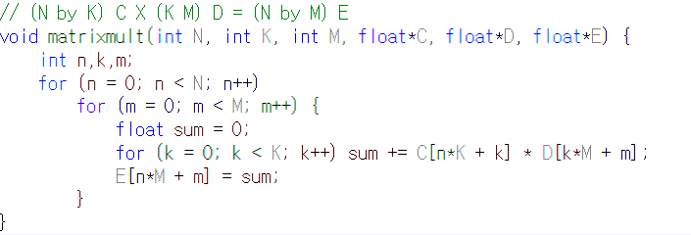
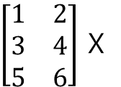

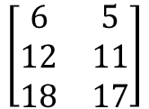
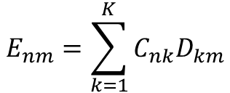
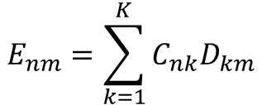
Matrix multiplication
CD = E
N=3
K=2
M=2
$\left[\begin{matrix}1 & 2 \\ 3 & 4 \\ 5 & 6\end{matrix}\right]$ X
$$\left[\begin{matrix}6 & 5 \\ 12 & 11 \\ 18 & 17\end{matrix}\right]$$
$\left[\begin{matrix}0 & 1 \\ 3 & 2\end{matrix}\right]$=
$$E_{nm}=\sum_{k=1}^{K}{C_{nk}D_{km}}$$
$$E_{nm}=\sum_{k=1}^{K}{C_{nk}D_{km}}$$

Slide 6
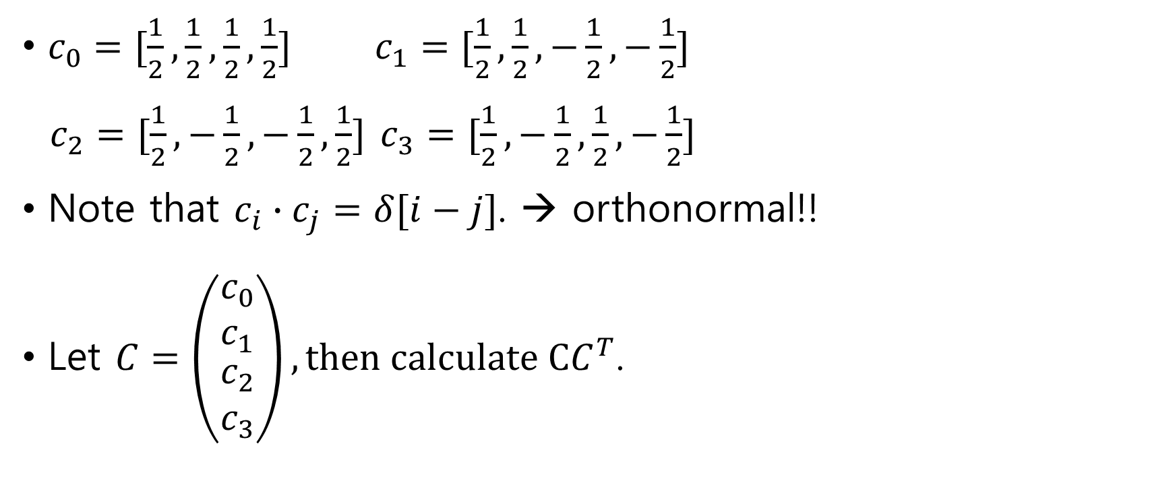
Orthogonality + normal = Orthonormal
$c_{0}=[\frac{1}{2},\frac{1}{2},\frac{1}{2},\frac{1}{2}]$ $c_{1}=[\frac{1}{2},\frac{1}{2},−\frac{1}{2},−\frac{1}{2}]$
$c_{2}=[\frac{1}{2},−\frac{1}{2},−\frac{1}{2},\frac{1}{2}]$ $c_{3}=[\frac{1}{2},−\frac{1}{2},\frac{1}{2},−\frac{1}{2}]$
Note that $c_{i}∙c_{j}=δ[i−j]$. → orthonormal!!
Let $C=\left(\begin{matrix}c_{0} \\ c_{1} \\ \begin{matrix}c_{2} \\ c_{3}\end{matrix}\end{matrix}\right), then calculate CC^{T}$.

Slide 7

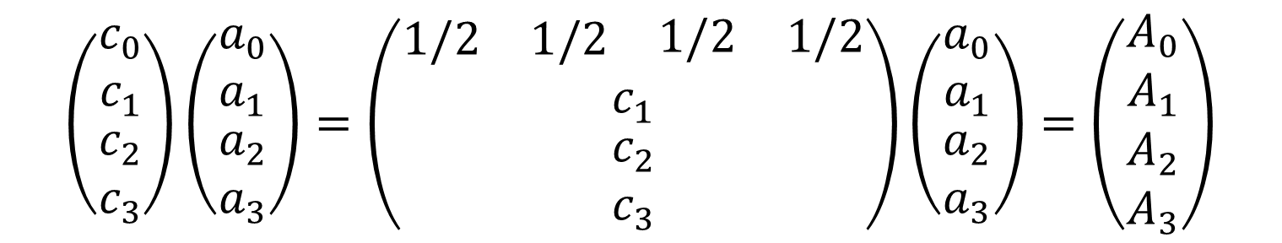
Transform and Inverse
Any 4-dimensional vector $\vec{a }$ can be represented by weighted sum of c_{i}’s.
$$\vec{a }=(a_{0} a_{1} a_{2} a_{3})=A_{0}c_{0}+A_{1}c_{1}+A_{2}c_{2}+A_{3}c_{3}$$
Transform a → A
$$\left(\begin{matrix}c_{0} \\ c_{1} \\ \begin{matrix}c_{2} \\ c_{3}\end{matrix}\end{matrix}\right)\left(\begin{matrix}a_{0} \\ a_{1} \\ \begin{matrix}a_{2} \\ a_{3}\end{matrix}\end{matrix}\right)=\left(\begin{matrix}\begin{matrix}1/2 & 1/2 & \begin{matrix}1/2 & 1/2\end{matrix}\end{matrix} \\ c_{1} \\ \begin{matrix}c_{2} \\ c_{3}\end{matrix}\end{matrix}\right)\left(\begin{matrix}a_{0} \\ a_{1} \\ \begin{matrix}a_{2} \\ a_{3}\end{matrix}\end{matrix}\right)=\left(\begin{matrix}A_{0} \\ A_{1} \\ \begin{matrix}A_{2} \\ A_{3}\end{matrix}\end{matrix}\right)$$

Slide 8

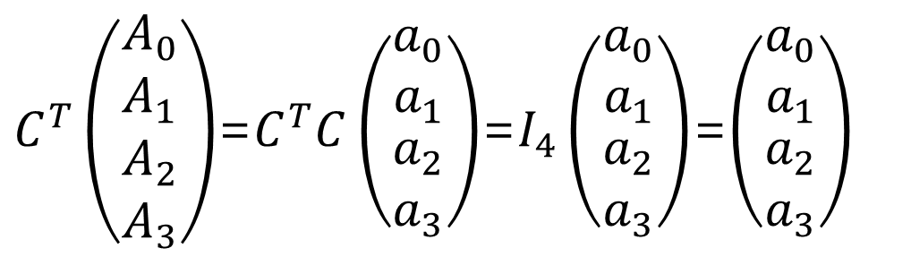

Inverse transform
$$\vec{a} ← \vec{A}$$
$\vec{a }=(a_{0} a_{1} a_{2} a_{3})=A_{0}c_{0}+A_{1}c_{1}+A_{2}c_{2}+A_{3}c_{3}$
$C^{T}\left(\begin{matrix}A_{0} \\ A_{1} \\ \begin{matrix}A_{2} \\ A_{3}\end{matrix}\end{matrix}\right)$=$C^{T}C\left(\begin{matrix}a_{0} \\ a_{1} \\ \begin{matrix}a_{2} \\ a_{3}\end{matrix}\end{matrix}\right)$=$I_{4}\left(\begin{matrix}a_{0} \\ a_{1} \\ \begin{matrix}a_{2} \\ a_{3}\end{matrix}\end{matrix}\right)$=$\left(\begin{matrix}a_{0} \\ a_{1} \\ \begin{matrix}a_{2} \\ a_{3}\end{matrix}\end{matrix}\right)$

Slide 9
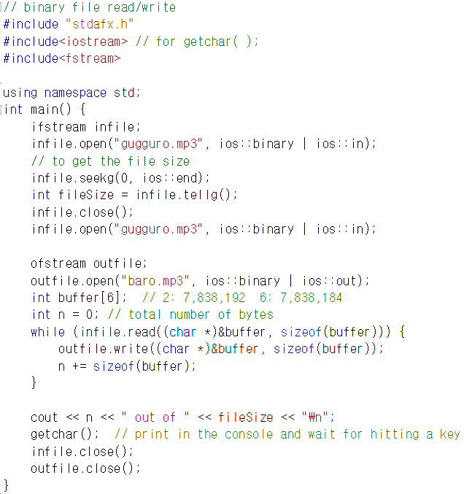
Binary file I/O

Slide 10
Assignment 1: orthogonality
Calculate CC^{T} by using the matrix multiplication program to make sure orthogonality where C as in page 6.
Change rows of C to make C’. (make a function to change rows of a matrix.)
Then, calculate C’ C^{T} and explain the results.

Slide 11
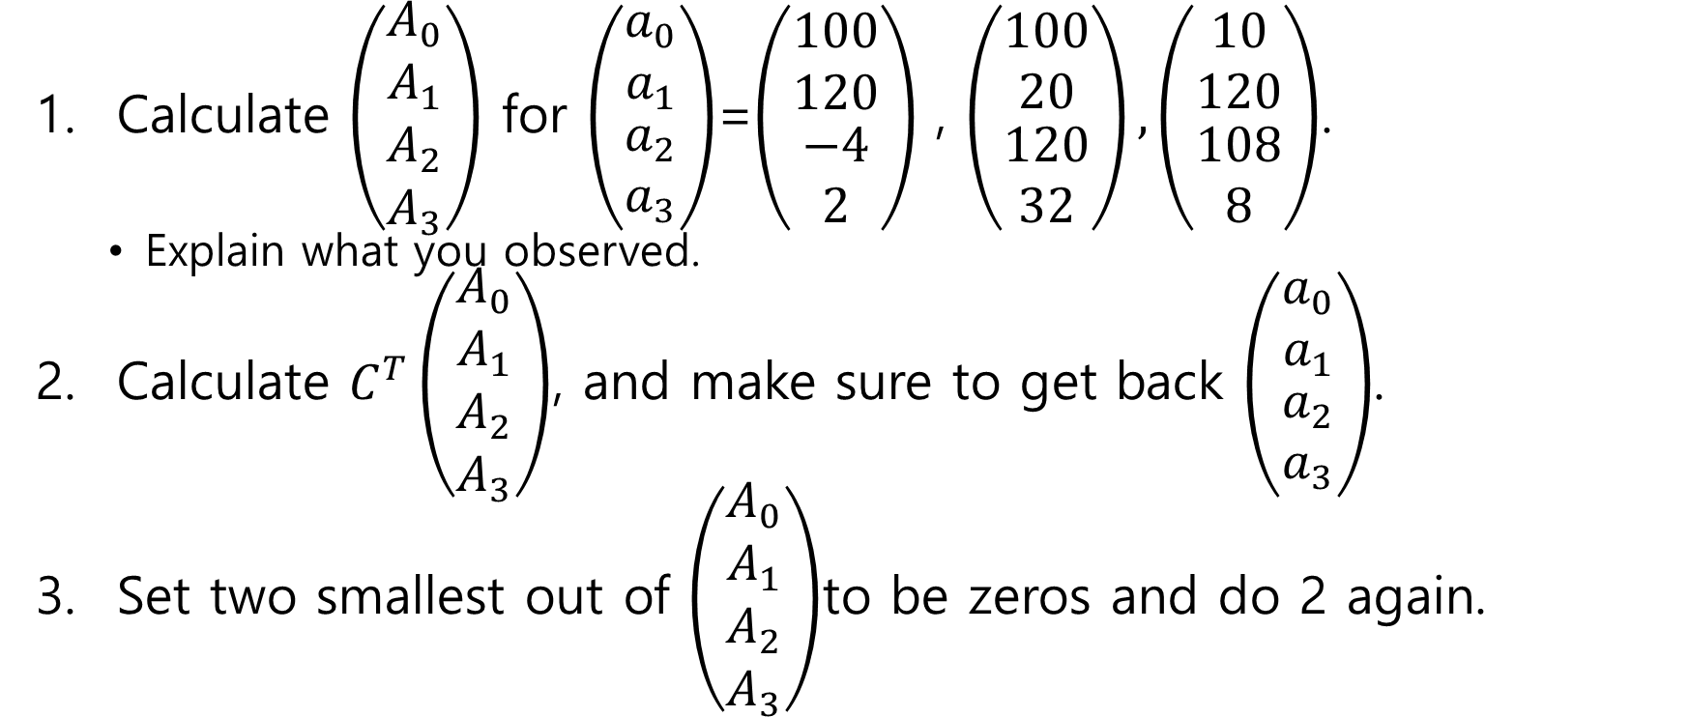
Assignment 2: transform and inverse
Calculate $\left(\begin{matrix}A_{0} \\ A_{1} \\ \begin{matrix}A_{2} \\ A_{3}\end{matrix}\end{matrix}\right)$ for $\left(\begin{matrix}a_{0} \\ a_{1} \\ \begin{matrix}a_{2} \\ a_{3}\end{matrix}\end{matrix}\right)$=$\left(\begin{matrix}100 \\ 120 \\ \begin{matrix}−4 \\ 2\end{matrix}\end{matrix}\right)$ , $\left(\begin{matrix}100 \\ 20 \\ \begin{matrix}120 \\ 32\end{matrix}\end{matrix}\right),\left(\begin{matrix}10 \\ 120 \\ \begin{matrix}108 \\ 8\end{matrix}\end{matrix}\right)$.
Explain what you observed.
Calculate $C^{T}\left(\begin{matrix}A_{0} \\ A_{1} \\ \begin{matrix}A_{2} \\ A_{3}\end{matrix}\end{matrix}\right)$, and make sure to get back $\left(\begin{matrix}a_{0} \\ a_{1} \\ \begin{matrix}a_{2} \\ a_{3}\end{matrix}\end{matrix}\right)$.
Set two smallest out of $\left(\begin{matrix}A_{0} \\ A_{1} \\ \begin{matrix}A_{2} \\ A_{3}\end{matrix}\end{matrix}\right)$to be zeros and do 2 again.

Slide 12
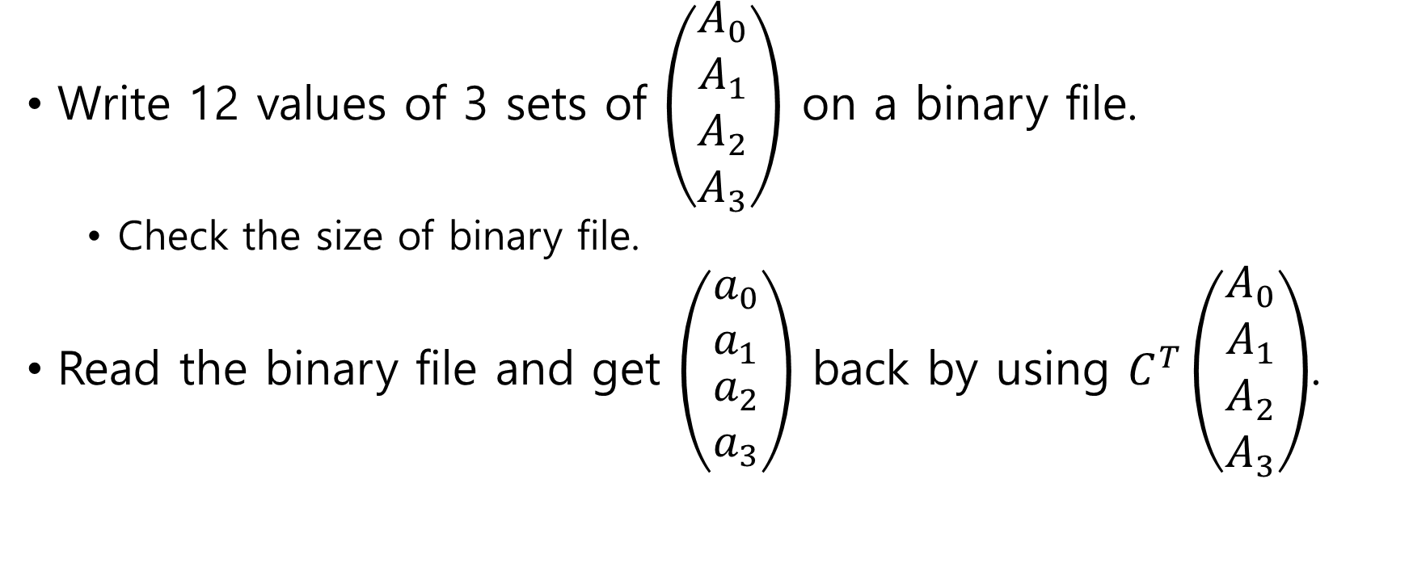
Assignment 3: binary file
$$\left(\begin{matrix}A_{0} \\ A_{1} \\ \begin{matrix}A_{2} \\ A_{3}\end{matrix}\end{matrix}\right)$$
$$\left(\begin{matrix}a_{0} \\ a_{1} \\ \begin{matrix}a_{2} \\ a_{3}\end{matrix}\end{matrix}\right)$$
$$C^{T}\left(\begin{matrix}A_{0} \\ A_{1} \\ \begin{matrix}A_{2} \\ A_{3}\end{matrix}\end{matrix}\right)$$

